Slide 1
Comprehensive Design Review
Team QuickTab
March 9th, 2017
Notes:
‹#›
‹#›
‹#›
‹#›

Slide 2
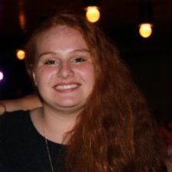
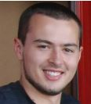
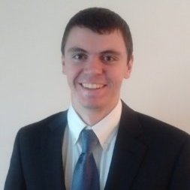
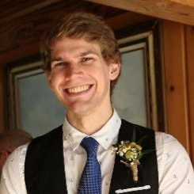
QuickTab (Intuitive Tablature Generation)
Joe Biegaj
EE
Lindsay Manning
EE
John Bonk
EE
Jacob Prescott
EE
Notes:
‹#›
‹#›
‹#›
‹#›

Slide 3
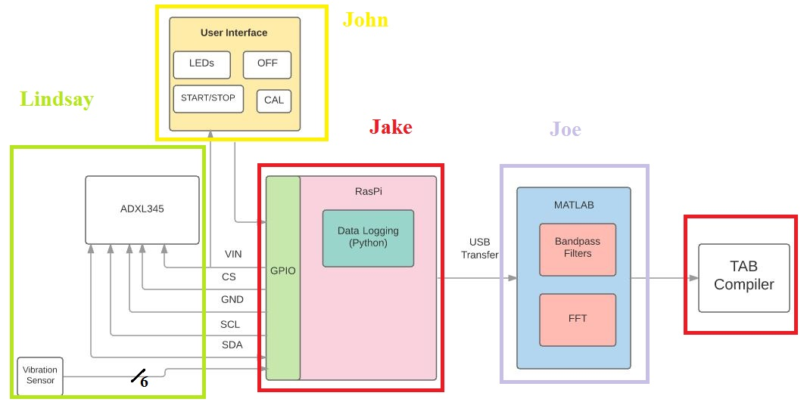
Block Diagram
Notes:
‹#›
‹#›
‹#›
‹#›
Lemon costs $1 (Good point)

Slide 4
Proposed CDR Deliverables
Data Logging
Data sampling rates will be matched and sample at a rate of greater than or equal to 2.1 KHz
We will accurately record 10 notes played over a 20 second time window
Over that 20 second time window, the correct strings will also be recorded for each note
Signal Processing
Our algorithm will be able to properly identify both the string and fret of the 10 notes
(Optional) Have a BPF Bank
Be able to visually output the frets played over a duration
User Interface
Buttons will be implemented for start/stop functionality
Speaker gives audible feedback on start/stop
A calibrate button will allow the user to verify the correct frequency for each string on their guitar
Preliminary PCB model will be designed in Eagle Software
Vibration sensors will be incorporated into the design
Vibration sensors will be able to identify which string is being played
Based off of these time stamps we will be able to match them with the frequency spikes we see
Notes:
‹#›
‹#›
‹#›
‹#›

Slide 5
Data Logging with Raspberry Pi
Data Sampling
Increased sampling frequency from the 1000Hz at MDR to a consistently working 1600Hz.
We first attempted to achieve the correct sampling rate by using data from only one axis, and while we could sample at a sufficient rate, the retrieved data was too inaccurate to process
Our successful solution was to change the baud rate of the I2C from the Raspberry Pi default of 100kHz to 800kHz
Unfortunately at 3200Hz there were problems recording both the FIFO values and vibration data at the same time
Fortunately, 1600Hz allows us to get both vibration data and 95.8% of the notes on the guitar
We can retrieve all notes except for the last five frets on the high E string
Notes:
‹#›
‹#›
‹#›
‹#›

Slide 6
Vibration Sensors
Sensor selection is finalized and implemented
on all six strings.
The output of the six piezo vibration sensors are fed into a 10-bit-to-Analog ADC that utilizes SPI.
The python script creates a file that lists which sensor was triggered and when it was triggered. This process is initialized by hitting the ‘record’ button on the UI.

Slide 7
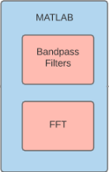
MATLAB
Raw ADXL and vibration sensor data is read in from the Raspberry Pi
A ‘for loop’ iterates through the sensor data to find out what strings were played
For each note detected a filter is applied that corresponds to the string played
The timestamp from the vibration sensors is used to determine where to take the FFT’s
Logical statements are then used to determine frequency and fret number

Slide 8
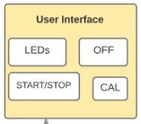
User Interface
Implementation of Start/Stop and Calibrate buttons have been added with full functionality
In place of the speaker, we decided LEDs would be a better fit
More noticeable
Easier to understand what each light means vs sounds
Saves a lot of space
LED Meanings:
Green: Ready to record/calibrate
Red: Currently Recording
White: Currently Calibrating

Slide 9
Creating Tablature (TAB Compiler)
Using the processed data from the MATLAB, we will create six arrays that utilize fret, string, and timestamp to print tablature of the recorded signal
Example:
e |-----------------0--|
B |-----------0--------|
G |-----1--------------|
D |--------------2-----|
A |--------2-----------|
E |--0-----------------|
Notes:
‹#›
‹#›
‹#›
‹#›

Slide 10
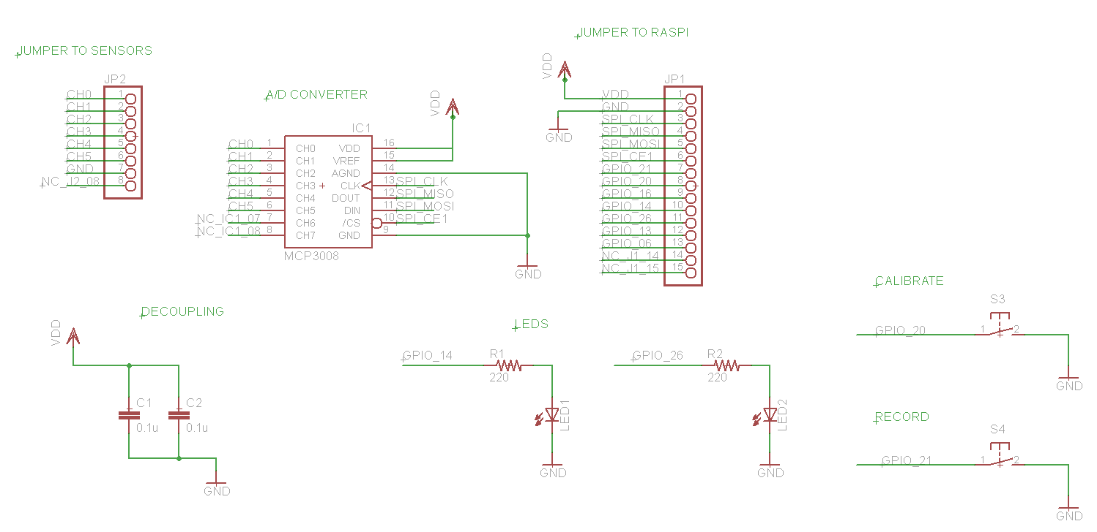
Preliminary PCB Model (Schematic)

Slide 11
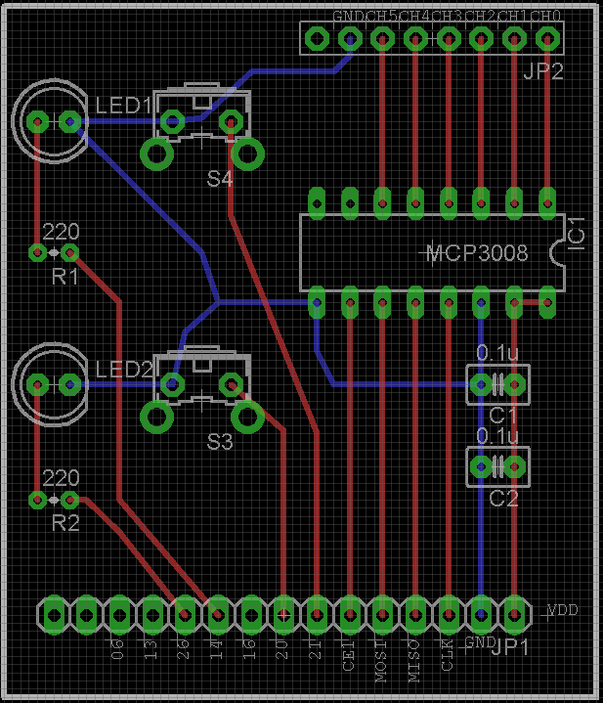
Preliminary PCB Model (Board Layout)

Slide 12
Proposed FPR Deliverables
Completely integrated and packaged system capable of tablature recovery with at least 90% accuracy over a signal containing 25 notes.
John
Remove the need for a visual display on the Raspberry Pi
Integrate PCB
Global ‘OFF’ button
Jake
Implement visualization of TAB Compiler
Enable user-friendly data transmission between Raspberry Pi and Computer
Joe
Improve FFT logic in order to achieve 90% fret detection accuracy
Implement calibration into MATLAB code
Lindsay
Optimize vibration sensor thresholds to improve FFT analysis
3D printed casing for the sensor strip and PCB

Slide 13
Thank You
Please Join Us in the Lab
Notes:
‹#›
‹#›
‹#›
‹#›

